Slide 1
Rockbuster Streaming
File created on: 11/7/2022 9:00:37 PM

Slide 2
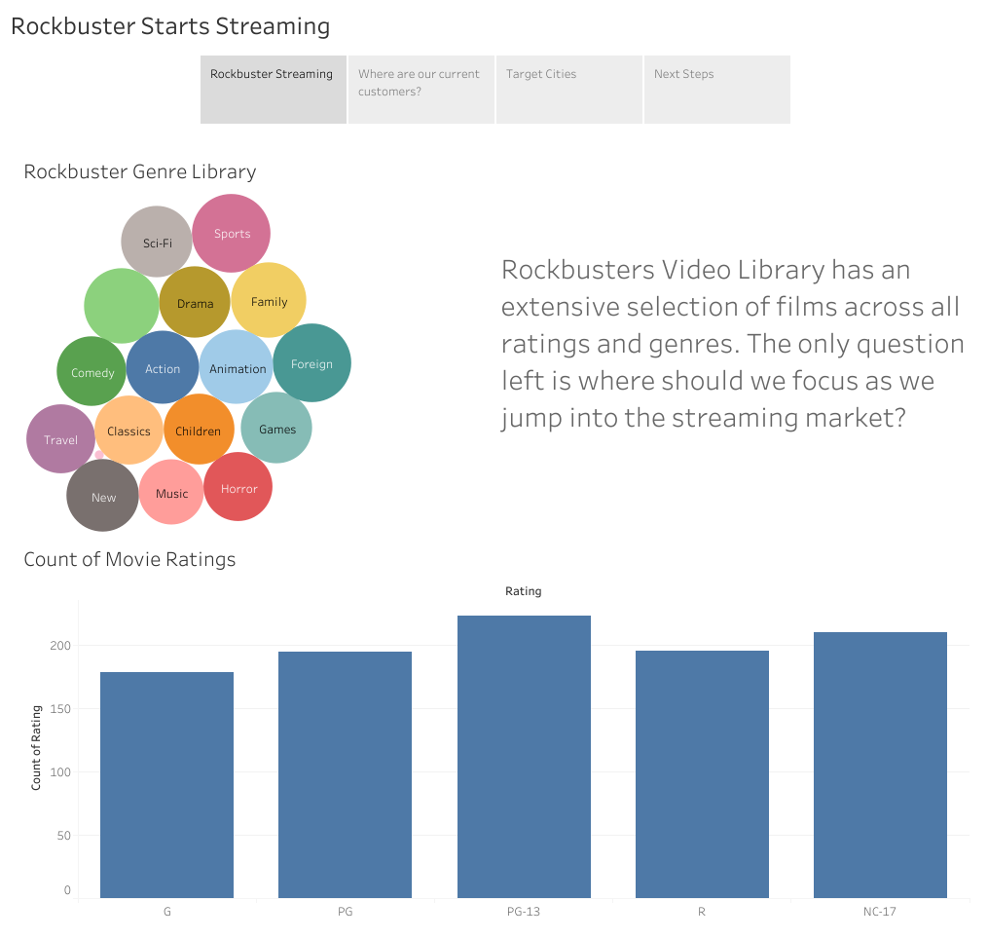

Slide 3
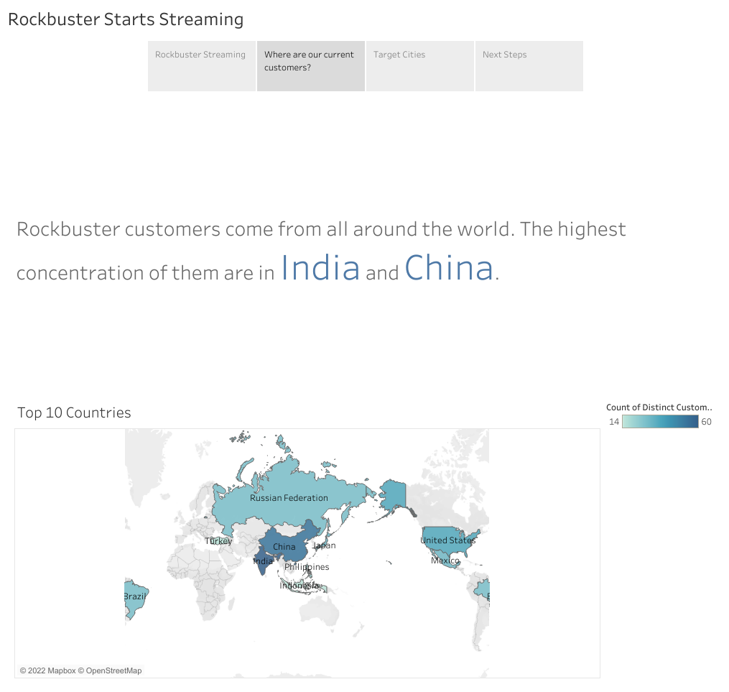

Slide 4
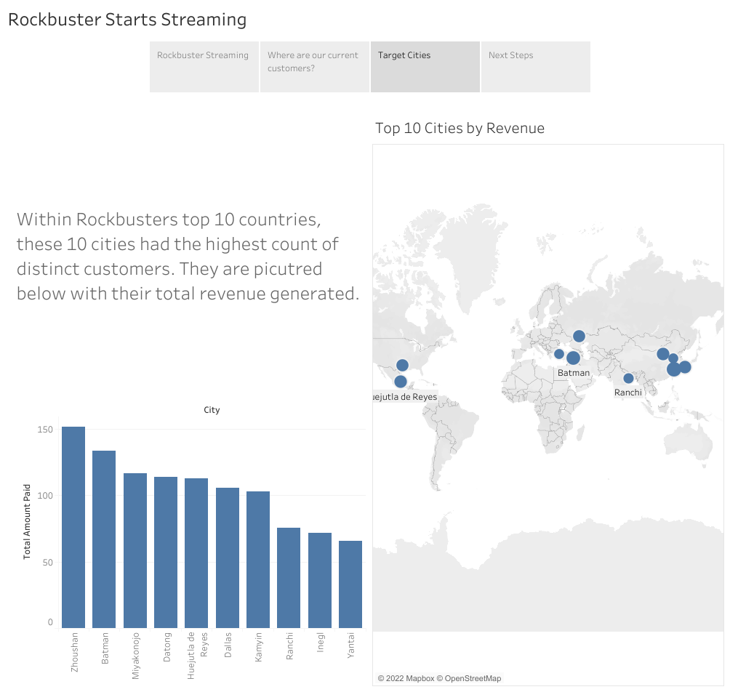

Slide 5
